Slide 1



Slide 2

Doctor Alkatraps, with the help of a biologist friend, took a bunch of computer code and compiled it into a genetic sequence of a species that he believed would be perfect for habitation of the planet Mars. He named the new species he had created the memk, because scientists are bad at naming things. Beef Wellington was born, his name coming from his sneaky attempt to steal some leftover beef wellington from the doctor’s refrigerator the day after he was born. Beef Wellington was split into two people during the great split, as his alternate timeline selves managed to collide exactly into each other during the universal rift. He decides that his two halves shall be named Beef and Wellington. Beef exists in the red universe and Wellington dwells in the blue universe.

Slide 3


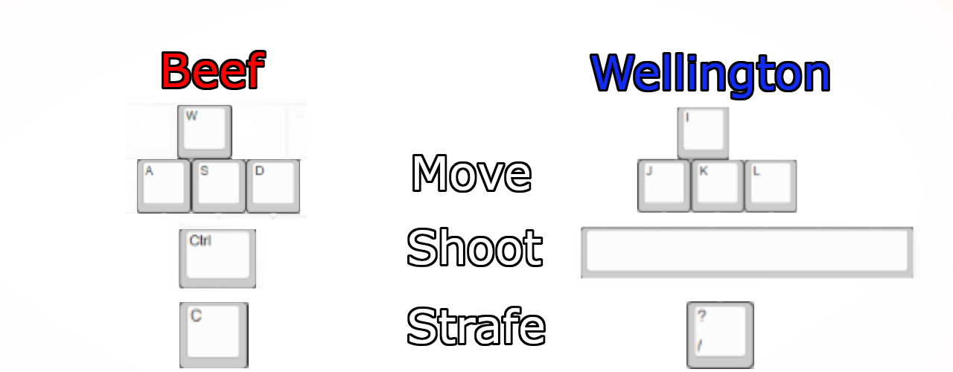
ESC can be pressed at any time to pause the game.

Slide 4





Tinted Timelines’ takes place in a sci-fi world where time has been broken into two parallel universes. This means that the actions of each player has effects on both their timeline, and the other. Enemies and bullets are able to move when the time matches theirs, indicated by the top of the screen.
Neither time is moving, all enemies and bullets will freeze.
Blue time is moving, red enemies and bullets will freeze, blue enemies and bullets will move.
Red time is moving, blue enemies and bullets will freeze, red enemies and bullets will move.
Purple time means all objects are able to move.

Slide 5
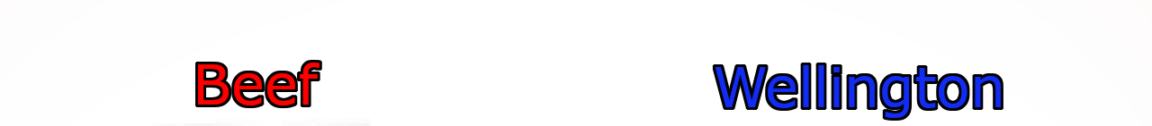


Attacks enemies
Attacks enemies
Damaged by bullets
Damaged by bullets
Moves time
Moves time
Players must work together in order to clear out enemies in each room. Doors can only be entered once all enemies have been destroyed.

Slide 6

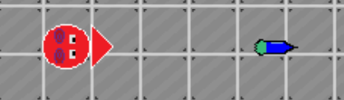

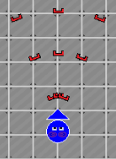



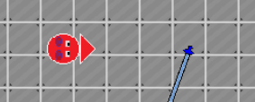
Dart Gun:
The starting weapon for each player, low damage and moderate reload.
Staple Gun:
A rapid-reload, spread fire weapon that shreds enemies at close range.
Sword Patch:
A weapon with a melee attack, followed by a thrown projectile. Slow but high damage.

Slide 7


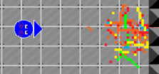
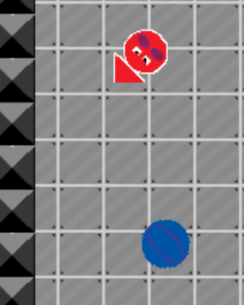

Rocket Launcher:
Slow-reloading, high speed projectile weapon with an AOE explosion that deals damage over time to enemies.
Rubber Ball Shooter:
Moderate reload, chaotic projectile that bounces around the room.

Slide 8




Heart:
Restores 10% of health.
Watt:
Reduces reload time for all weapons by 5%, max 10 per hero.
?
???:
The true reason behind the split in time.

Slide 9








Blobbot:
The most basic robot in the lab, patrols a small area and fires slime
balls.
?
Slicer Bot:
A highly dangerous melee bot, chases the heroes down with rapidly spinning swords.
Rubber Ball Slinger
A moderately powerful bot designed to catch the heroes by surprise with ricochet shots.
???:
An unknown experiment

Slide 10

Royalty- Free Music Downloaded from:
patrickdearteaga.com
Everything Else: George Karachepone, Richard Thompson, Steven Vennard

